Slide 1
Comparative Analysis of ROS-1, ROS-2 and ROS-I
Tanmay Vilas Samak

Slide 2
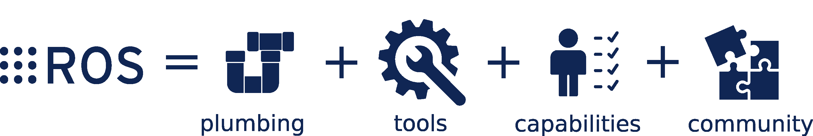
Overview
Robot Operating System (ROS) is a meta-OS
Plumbing: communication middleware (e.g. nodes, topics, messages, services, etc.)
Tools: monitor, visualize and debug (e.g. rqt, rviz, etc.)
Capabilities: out-of-the-box support for robot mobility and manipulation (e.g. perception, planning, control)
Community: developers and contributors across the globe (e.g. Open Robotics, Autoware, F1Tenth, etc.)
Source: ROS.org

Slide 3
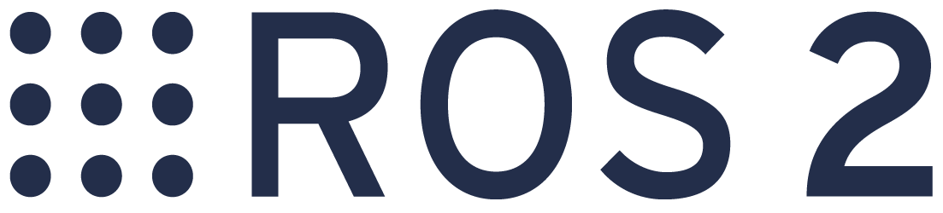
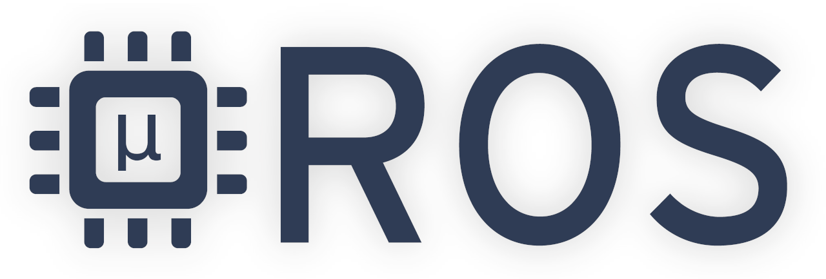
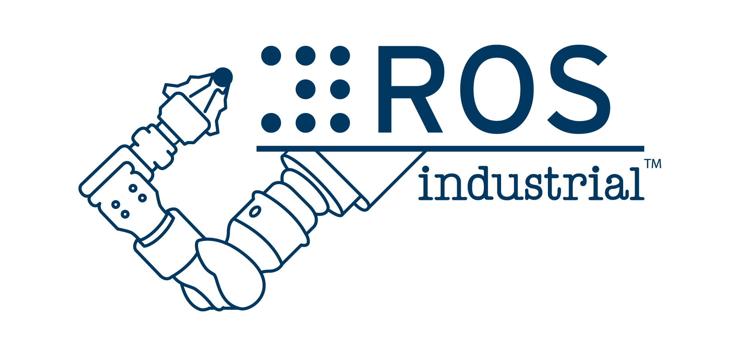


Overview
ROS roadmap
ROS-1: Developed for PR2, extended for academic R&D
ROS-2: Extension of ROS with new, lightweight middleware
$μ$-ROS: Support for embedded and real-time applications
ROS-I: Extension of ROS to industrial robots and standards

Slide 4
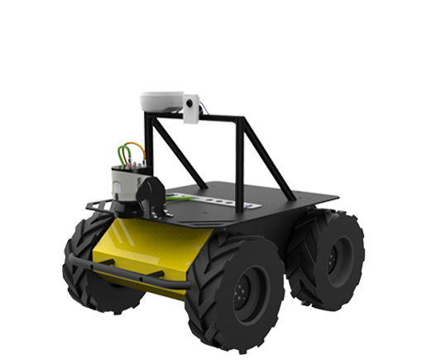
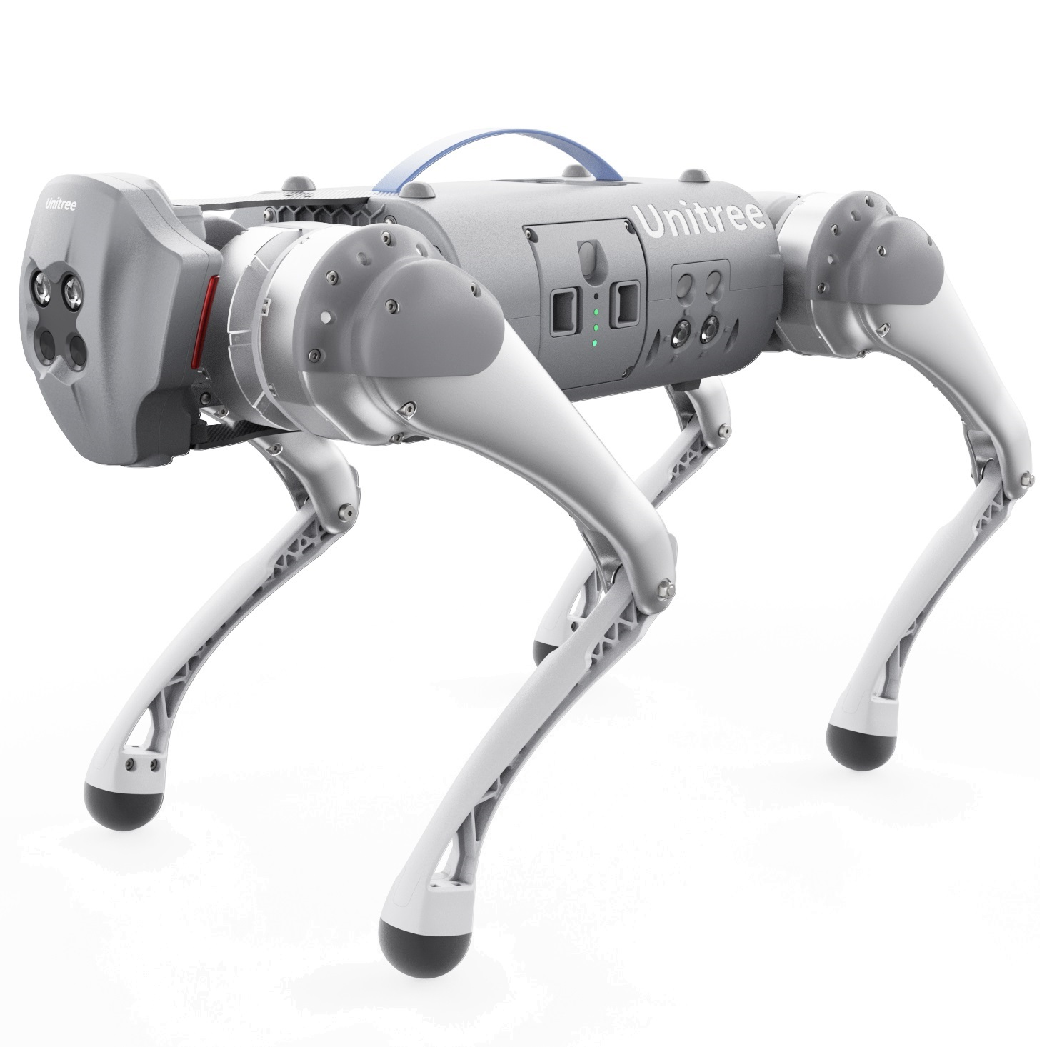
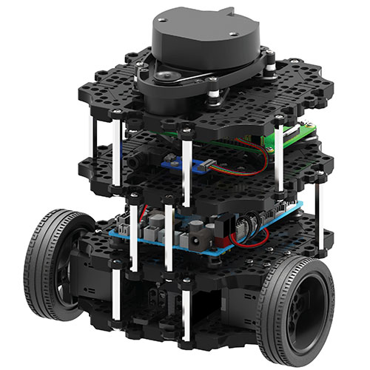
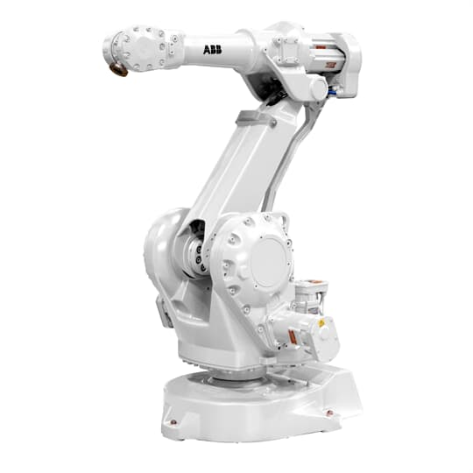
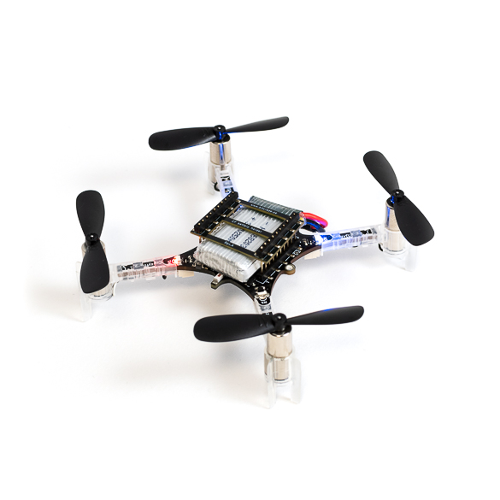
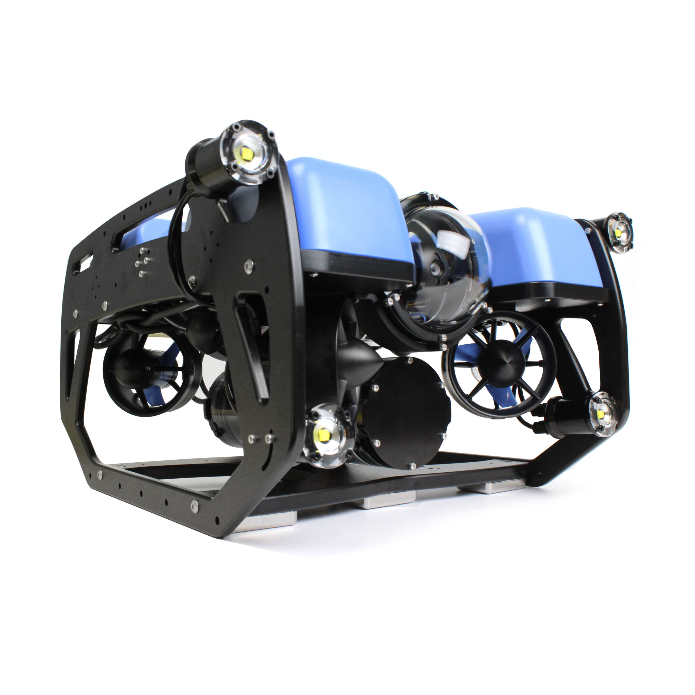
Applications
ROS-1
Hobby and academic robots (manipulator + mobile) across varying scales
ROS official robot - TurtleBot
List of robots supported by ROS
List of companies using ROS
ROS-2
Most/all ROS-1 robots are migrating to ROS-2
List of robots running ROS-2
ROS-I
Industrial robots (mostly manipulators as of now) and equipment (PLC, HMI, IO Networks, etc.)
List of supported hardware
From hobby projects to industrial robots, and everything in between!
Source: Clearpath
Source: Unitree
Source: ROBOTIS
Source: Bitcraze
Source: BlueRobotics
Source: ABB

Slide 5
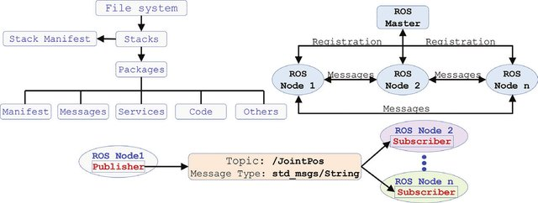
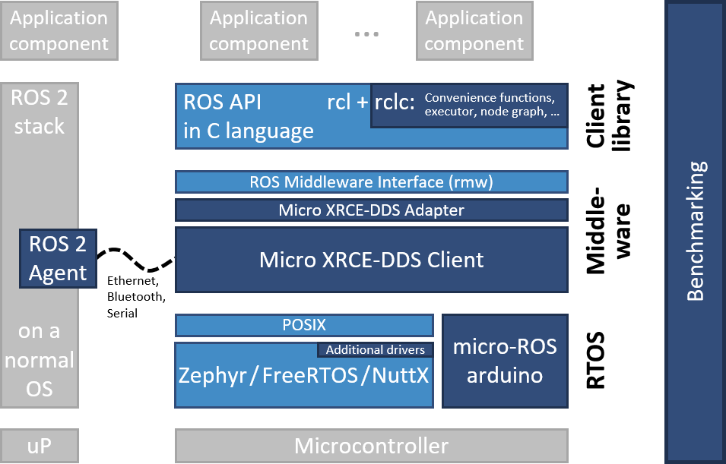
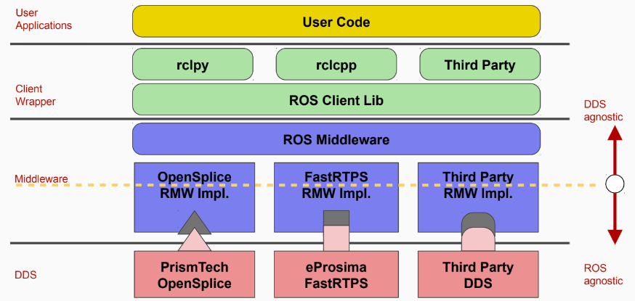
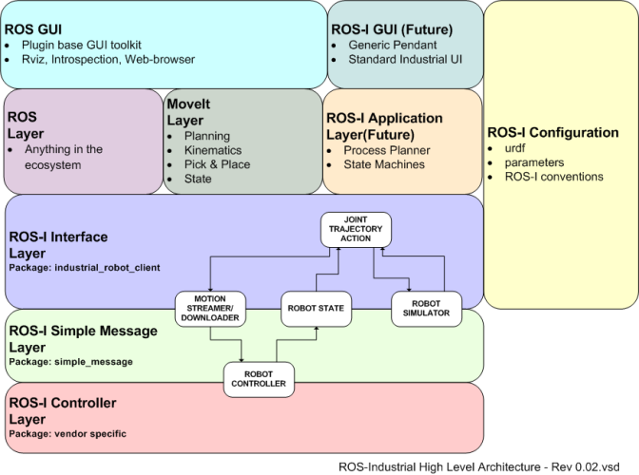

Deployment Architecture
ROS-1
$μ$-ROS
Source: ROS.org
Source: [3]
ROS-2
ROS-I
Source: ROS.org
Source: ROS.org

Slide 6
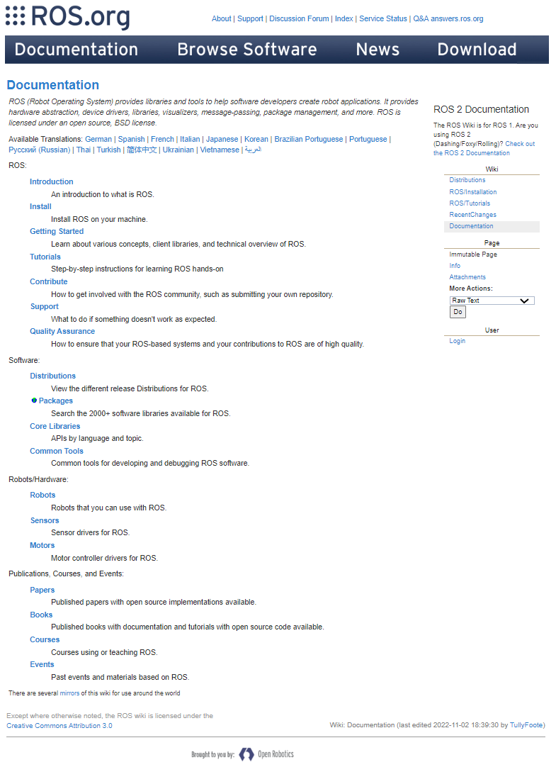
Resources
Documentation homepage (ROS-1 + ROS-2): https://docs.ros.org
ROS wiki, installation and tutorials; ROS-I wiki
YouTube videos
ROS Tutorials by Justin Huang
ROS-TurtleBot Tutorials by Tinker Twins
MOOCs centred around ROS-1 and ROS-2
Programming for Robotics - ROS, ETH Zurich
Hello (Real) World with ROS – Robot Operating System, TU Delft
Udemy courses
Books for learning ROS
ROS Robot Programming, A Handbook is written by TurtleBot3 Developers

Slide 7
Comparative Analysis
Criteria | ROS-1 | ROS-2 | ROS-I
Architecture | Centralized Discovery | Distributed Discovery | Centralized Discovery
Multi-Agent Support | Not ideally | Yes | Future
Real-Time Capability | No | Yes | Future
Embedded Platforms | Partially | Yes | Yes
Non-Ideal Networks | No | Yes | Future
Life-Cycle Management | No | Yes | Future
Industrial Support | No | No | Yes
Documentation | Mature | Increasing | Ongoing
Maintenance Support | Nearing EOL | Increasing | Increasing
Language Support | C++03/11, Python2 | C++11/14/17, Python3 | C++03/11, Python2
OS Support | Linux, macOS | Linux, macOS, Windows, RTOS | Linux, macOS
Recommended Scope* | Hobby, Academic | Professional, Real-Time | Industrial
*Recommendation is based on critical analysis presented in rows 1-11

Slide 8
References
M. Quigley, K. Conley, B. Gerkey, J. Faust, T. Foote, J. Leibs, R. Wheeler, and A. Ng, “ROS: an open-source Robot Operating System,” in ICRA 2009 Workshop on Open Source Software, vol. 3, Jan 2009. [Online]. Available: http://robotics.stanford.edu/~ang/papers/icraoss09-ROS.pdf
S. Macenski, T. Foote, B. Gerkey, C. Lalancette, and W. Woodall, “Robot operating system 2: Design, architecture, and uses in the wild,” Science Robotics, vol. 7, no. 66, p. eabm6074, 2022. [Online]. Available: https://www.science.org/doi/abs/10.1126/scirobotics.abm6074
R. R. Shamshiri, I. A. Hameed, and M. K. a. Weltzien, "Robotic Harvesting of Fruiting Vegetables: A Simulation Approach in V-REP, ROS and MATLAB", in Automation in Agriculture - Securing Food Supplies for Future Generations. London, United Kingdom: IntechOpen, 2018 [Online]. Available: https://www.intechopen.com/chapters/59402 doi: 10.5772/intechopen.73861

Slide 9
Thank You!

